Slide 1
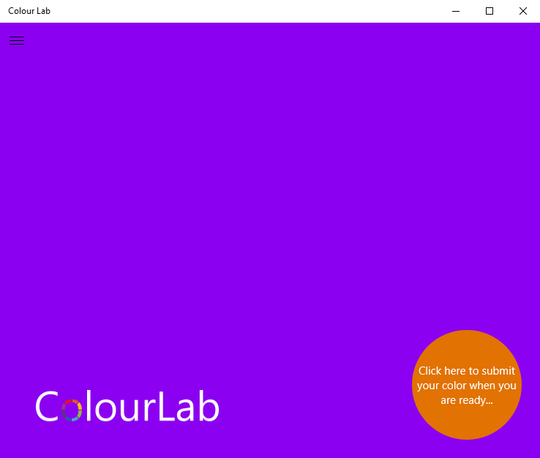
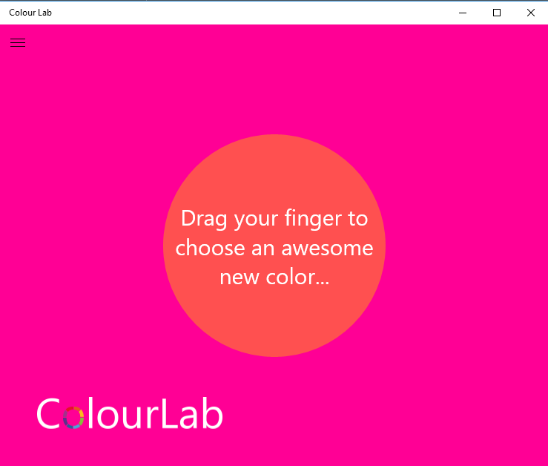
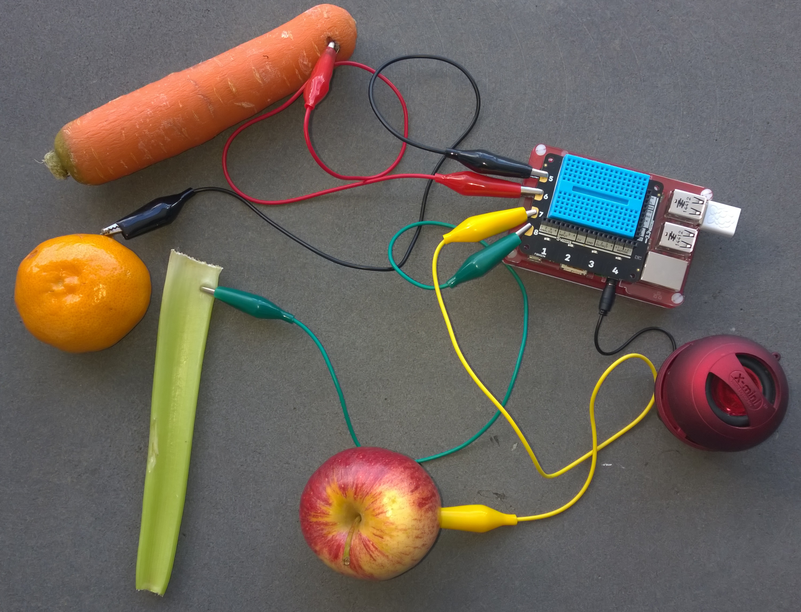
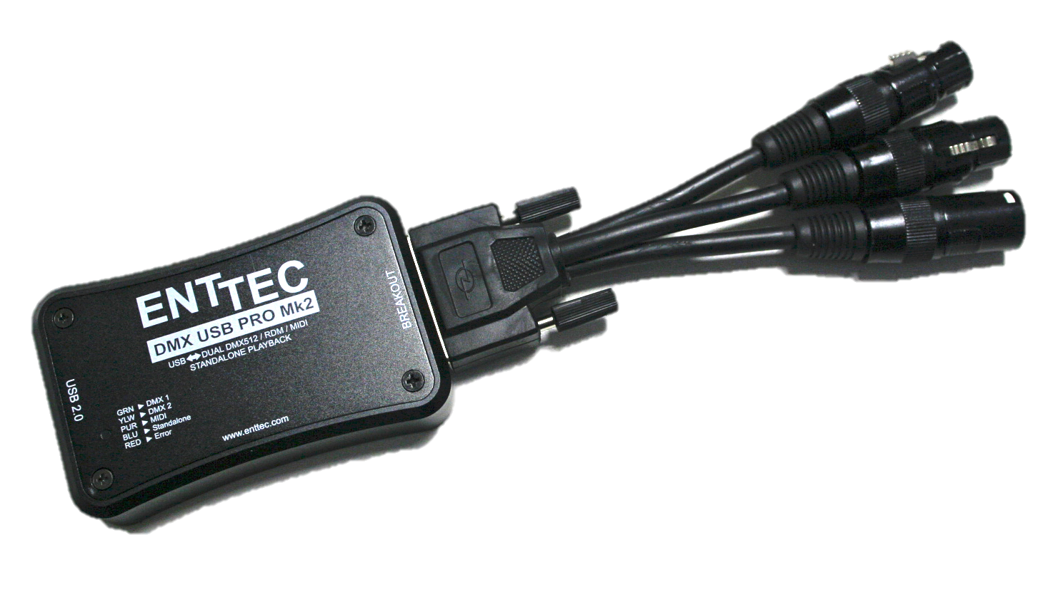
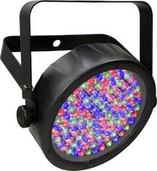
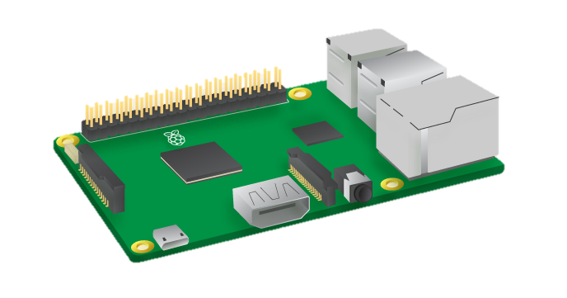
DMX Client
Any device capable of publishing
a JSON Colour Message over MQTT
{“id”,[1,2],”red”:20,”blue”:155}
{"id":[1,2,3],"data":"/6T1AAAAAA=="}
{“id”,[3],”red”:255,”green”:100,”}
universe.json Reference Table
MQTT BROKER
Mosquitto
Azure IoT Hub or
[
{
"desc": "SlimPar Q12 Quad Light Powerhouse",
"fixtureId": 1,
"startChannel": 1,
"numberOfChannels": 4,
"initialChannelMask": [ 0, 0, 0, 0 ],
"redChannels": [ 1 ],
"greenChannels": [ 2 ],
"blueChannels": [ 3 ],
"autoPlayId": "rgbLight"
},
{
"desc": "SlimPar Q12 Quad Light Powerhouse",
"fixtureId": 2,
"startChannel": 5,
"numberOfChannels": 4,
"initialChannelMask": [ 0, 0, 0, 0 ],
"redChannels": [ 1 ],
"greenChannels": [ 2 ],
"blueChannels": [ 3 ],
"autoPlayId": "rgbLight"
}
]
Fixture Id:1
Fixture Id:2
Fixture Id:3
.NET DMX Server
Windows or
Mono on Raspbian

